Slide 1
Incoming Panther Presentation

Slide 2
Counselors
Mrs. Choi: A-Da
Ms. Coleman: De-I
Mrs. Nedwick: J-Mo
Ms. Cortes: Mu-Sanc (and EL/Newcomers)
Mr. Napora: Sand-Z

Slide 3
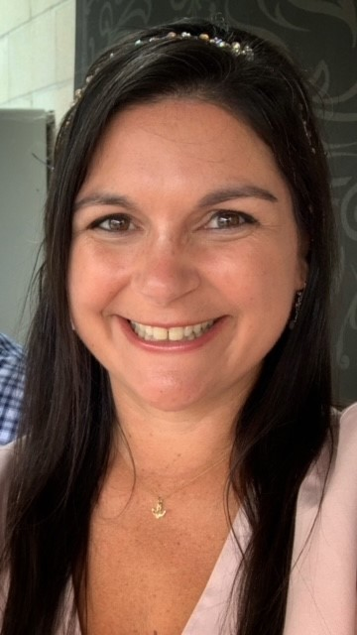
College and Career Center
Brittany Hong- College and Career Center Coordinator
Nick Guerin – Career Ed. Coordinator

Slide 4
CVUSD Graduation Requirements
Students must earn 230 credits and complete at least Algebra 1 in order to meet graduation requirements
Most classes are 10 credits (6 classes per year = 60 credits total)

Slide 5
Graduation Requirements by Subject
English 9,10,11,12 40 credits
Math (including Algebra 1) 30 credits
Physical Science 10 credits
Biology 10 credits
Health 5 credits
Physical Education 20 credits
World History 10 credits
United States History 10 credits
U.S. Government 5 credits
Economics Systems 5 credits
CTE / VPA / World Language 10 credits
Electives 75 credits
Total Required Credits: 230

Slide 6
University of California / California State University
“A-G” Requirements

Slide 7
Freshmen are required to take SIX CLASSES
English
Math
Science
Physical Education (or NP sport)
Health/Careers & Geography
Elective

Slide 11
Course Selection Contract:

Slide 12
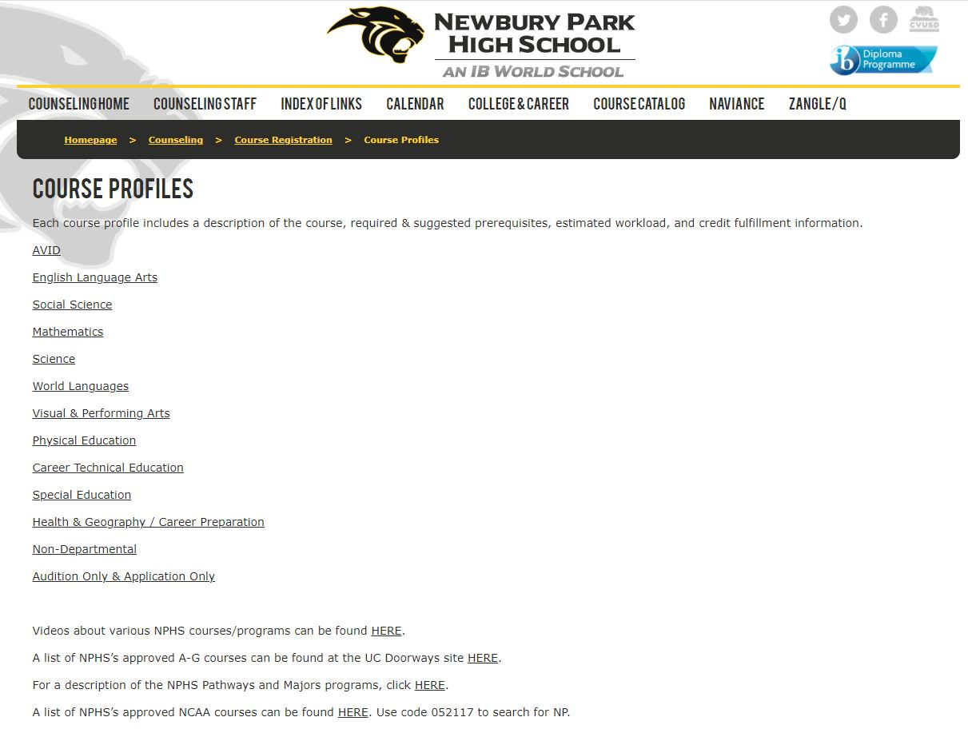

Slide 13
What is AVID?
Advancement Via Individual Determination
UC/CSU Approved elective Course
A schoolwide college readiness system
Direct support for college bound students
AVID Student Profile
GPA of 2.0 to 3.5.
Come from an “underrepresented” group.
First Generation to College
Low Income Family
Special Circumstances
Able to complete four-year university requirements prior to graduation.
Hard working have a positive attitude, and be collaborative in nature.
Need support in rigorous courses (H, AP,IB, Dual-Enrollment)
Notes:
So, WHAT IS AVID?
AVID is a schoolwide college-readiness system that works to influence the instruction, systems, leadership, and culture of the entire campus.
AVID addresses college readiness for ALL students, particularly those who would be first-generation college-goers.

Slide 14
How AVID Works
Teaches content-specific strategies for reading, writing, thinking, and speaking
Accelerates students who have potential into more rigorous courses
Teaches academic and social skills not targeted in other classes
Provides intensive support with in-class tutors and a strong student/teacher relationship
Develops a sense of hope and personal achievement gained through hard work and determination
Creates a positive peer group for students
For more information email
Lesley Nedwick lesleynedwick@conejousd.org or
Edith Cortes (español) ecortes@conejousd.org

Slide 15
Inclusive Academic Offerings
NPHS offers specific specialized academic programs to meet the needs of all students.
Students with individual education plans (IEPs) will work with their middle school case managers to determine appropriate course placement for grade 9.
Your child’s IEP “transition” meeting will determine appropriate classes. The counselor will make schedule changes as needed based on the IEP transition meeting.

Slide 16
Honors/AP/IB
The Registration Instructions:
B or above final grade in current honors course to move to the next honors course OR Academic Waiver Form
A as a final grade in current CP course to take the next level honors course OR Academic Waiver Form
The Reality:
Even if a student meets the minimum requirements to enroll in an honors class it does not mean that doing so is ideal. Some important things for students and parents to consider are:
Is the student genuinely interested in the subject?
Is the subject an inherent strength for the student?
Does the student have the work ethic required for success in an honors class?
Does the student have the time to devote to the honors class?
Does the student ask questions/seek assistance/attend school-based tutoring?
If the answer to even ONE of these aspects is NO, honors may not be the best placement! Your student’s current teachers/counselors are the best source of accurate information for these considerations.

Slide 17
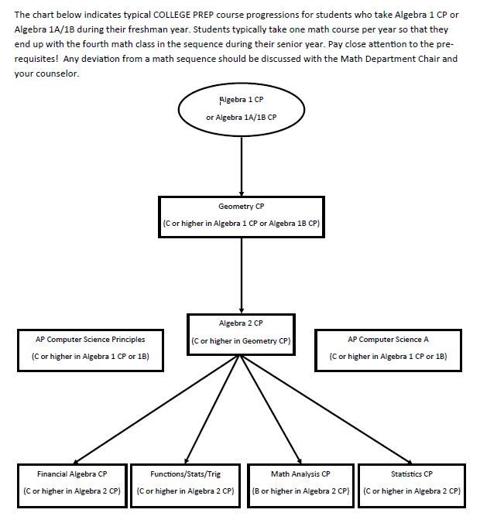
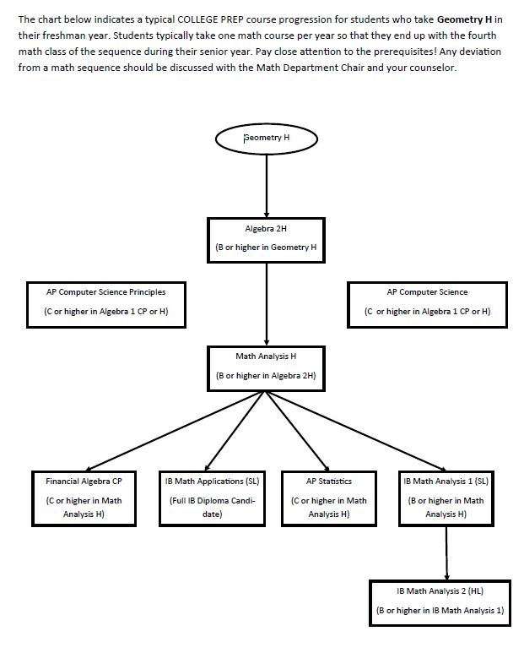
CP Math Sequence
H/AP/IB Math Sequence

Slide 18
Science Sequence

Slide 19
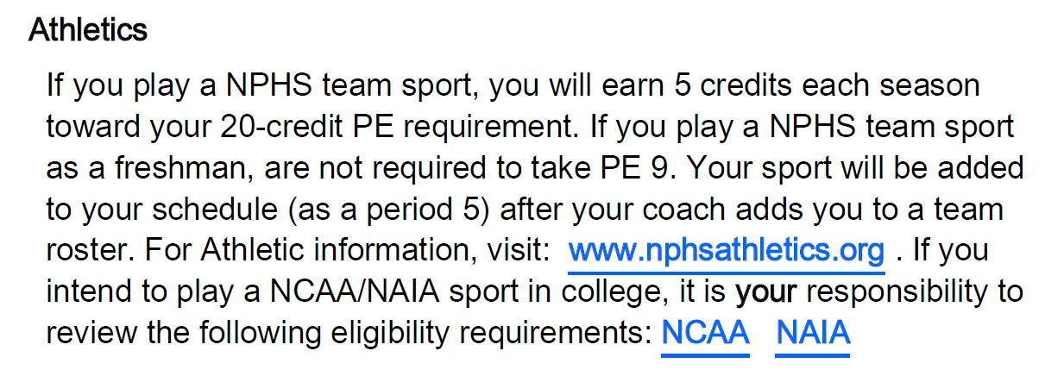

Slide 20
The Myths of Summer School
“I heard from my friend/neighbor/stranger that my child NEEDS TO/IS SUPPOSED TO take health/PE/etc. this summer.”
FALSE – Students have the opportunity to take 6 classes per year throughout high school, for a possible total of 240 credits…and they need only 230 to graduate.
2. “I want my child to get ahead and I heard taking math (or some other sequential course) in summer is a good idea.”
FALSE (generally) – Students who compress an entire year of a sequential subject (or one that is a prerequisite for another subject) results in far less time to cover important content. Many students who have chosen to do so struggle in the next sequential/higher level course(s).
Who SHOULD take summer school??
Students who seek to remediate a course in order to be able to succeed at the next level
Students who need to open a space in order to take a specific class or classes (NOT general electives)

Slide 21
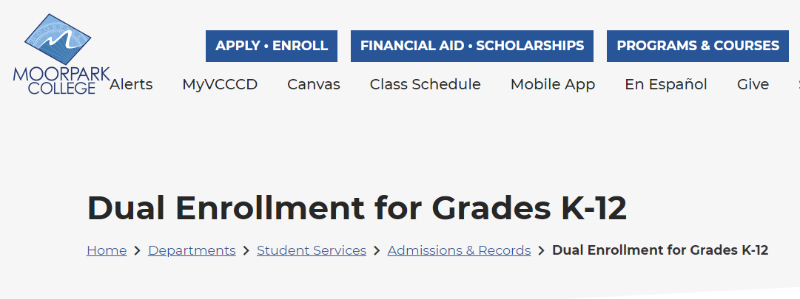
Accelerated Courses (Dual Enrollment) through Moorpark College
Articulated Classes (classes on NPHS campus earn college credit)
Moorpark College Course Registration Procedures

Slide 22
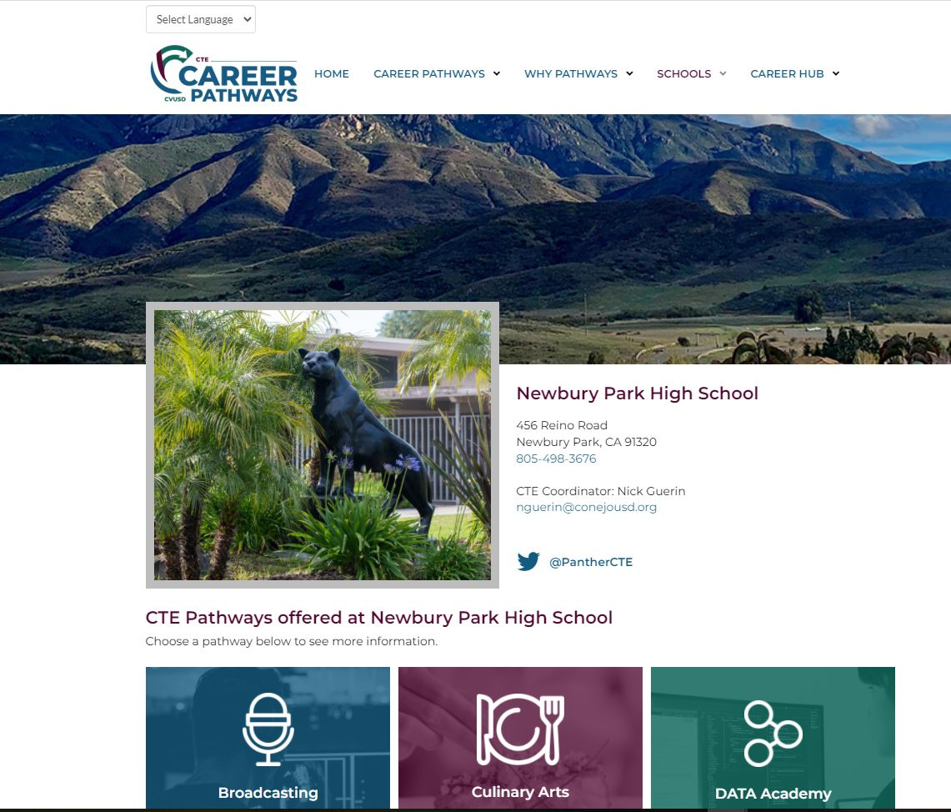
Career Pathways
https://conejocte.org/nphs/

Slide 23
If you decide to take a course off-campus, please read the District policy FIRST:
http://dev.nphs.org/wp-content/uploads/2020/02/Online-Guidelines-2020.pdf
YOU will be responsible for:
Finding the course provider (and making sure the provider is not only accredited but that they issue grades, credits, and an official transcript)
Paying for any tuition/fees (if there is a cost)
Providing an official transcript to NPHS after you complete the course (if you want it to be added to your NPHS transcript)

Slide 24
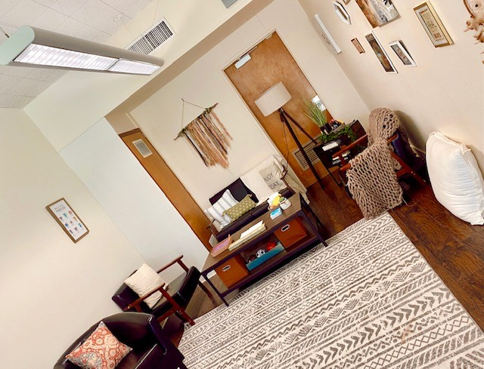
Wellness Center
The Wellness Center is intended to establish a support structure on campus focused on student’s mental health development and needs. There are various supports and services made available from the Wellness Center located in A3.
Paige Pensivy
Mental Health Clinician I

Slide 25
Wellness Center
Support Service Available
Drop-in support for students needing immediate social-emotional support
Self-initiated
Teacher recommended
Proactive ongoing individual counseling sessions to support a student who has an identified mental health risk factor. Referral required
Proactive ongoing small group counseling sessions to support students who have an identified mental health risk factor. Referral required
Monthly workshops on various topics
Wellness Thursdays in the Quad: Monthly topics and mental health awareness activities
Classroom presentations

Slide 26
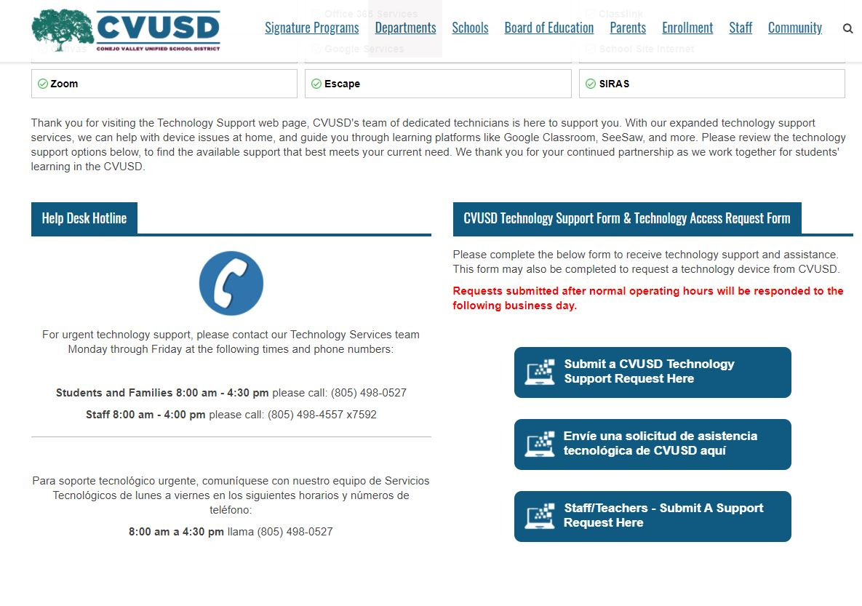
Technology Support

Slide 27
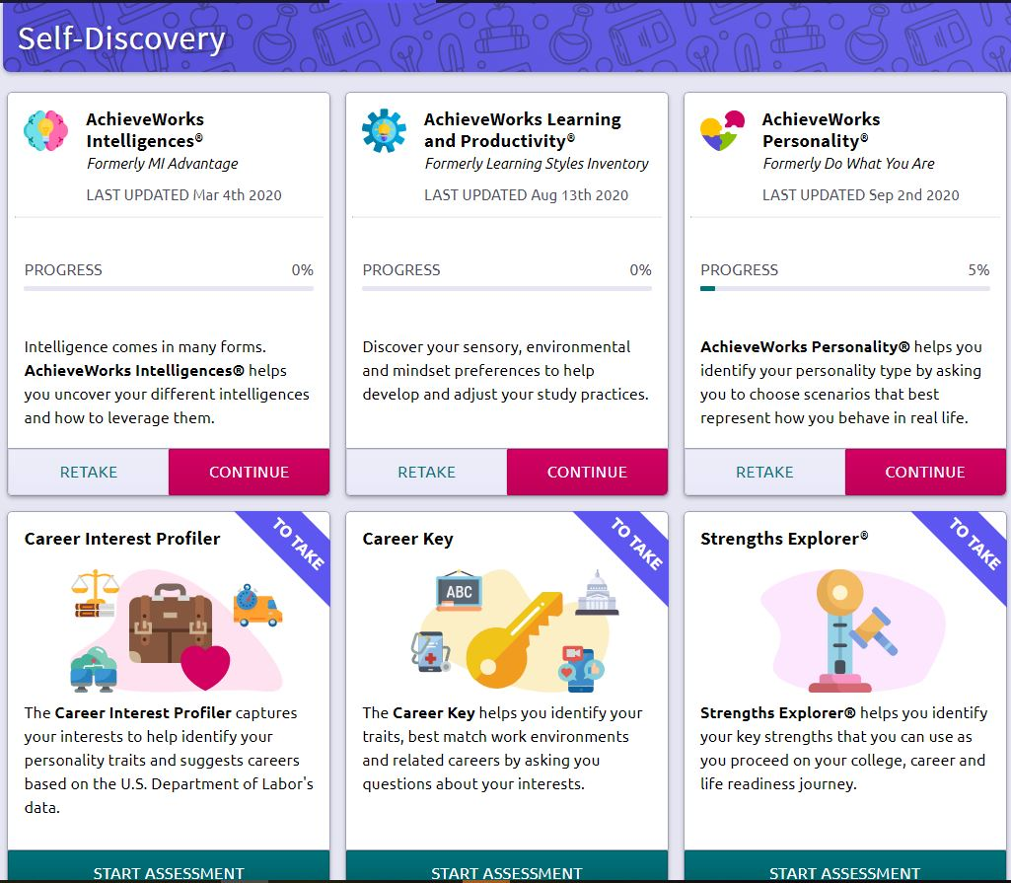
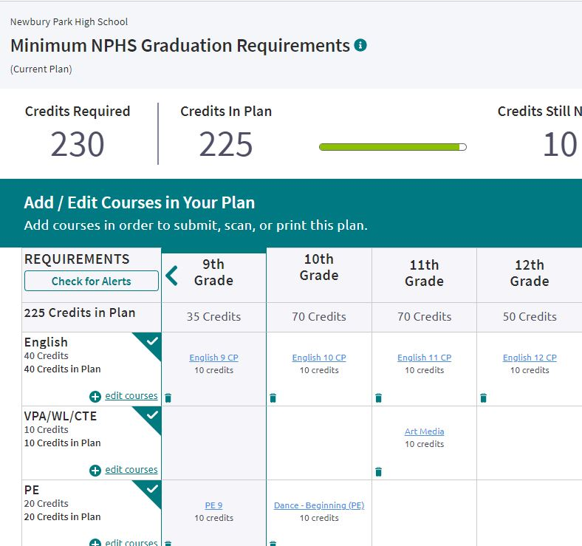
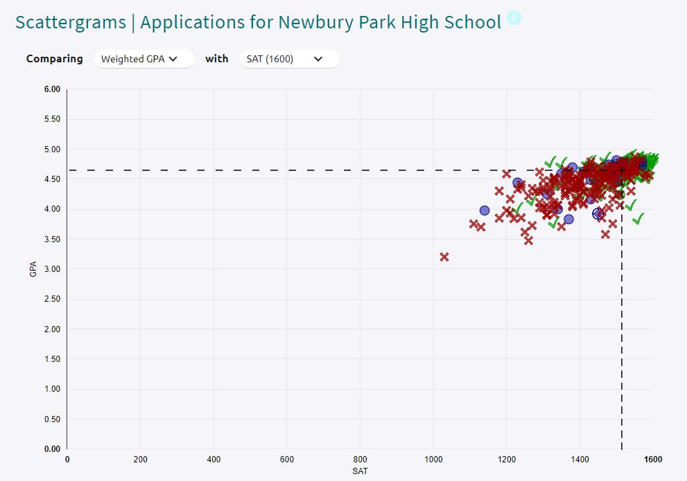
NAVIANCE

Slide 28
SPECIAL INTEREST AREAS
Extra/Co-Curricular Participation
Athletics (must have 2.0 GPA or higher to participate)
100+ Clubs
Music Program (orchestra, band, vocal, theater)
HONORS, ADVANCED PLACEMENT, INTERNATIONAL BACCALAUREATE
Digital Arts Technology Academy (DATA)
Majors Program
AVID

Slide 29
FUTURE PANTHER NIGHT
…STAY TUNED for more information about:
Music Performances
Club Information
Dance Team Demo
Counseling FAQs
Panther Athletes
Student Store
Sign Up for Sports and Clubs
…and much more!

Slide 30
FRESHMAN ORIENTATION
…STAY TUNED for upcoming dates for:
Tours
Mandatory ID Pictures
Pick up:
Schedule
Pre-purchased P.E. Clothes
Student Activity Card Cards
Text Books
Spirit Packs (if Purchased ahead of time)
FIRST DAY OF SCHOOL: August 24th, 2022

Slide 31
Visit our counseling webpage for important information

Slide 32
Thanks! Go Panthers!

